Slide 1
OVERVIEW OF UJT, RELAXATION OSCILLATOR

Slide 2
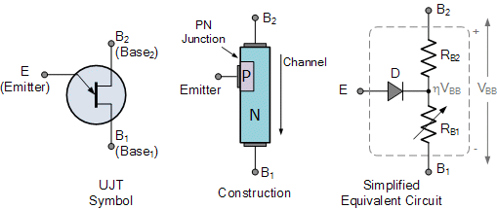
OVERVIEW OF UJT:
An UJT is formed from a P-type and the N-type material to create a single junction.
These transistors can be utilized during the switching of the devices to ON/OFF. They doesn’t suit for amplification techniques.

Slide 3
UJT Characteristics:
The characteristics of the UJT are as follows:
It requires very low amount of voltage to get triggered.
It is capable of controlling the current pulse.
It consists of the negative value of the resistance.
The cost of this transistor is very low.

Slide 4
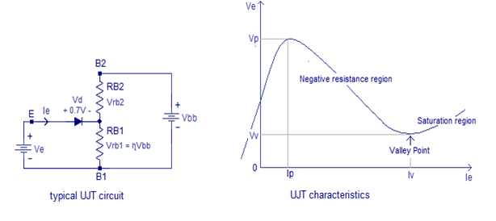
As the current in the UJT tends to increase there can be evident drop in voltage value. Hence this transistor shows the negative characteristics of resistance. This paves the way to make the UJT to work as a relaxation oscillator.

Slide 5
UJT RELAXATION OSCILLATOR:
UJT is a transistor with one junction.
This possesses the resistance with negative characteristics.
This makes the UJT to function as an oscillator.
This is an oscillator with the basic resistor and capacitor.
As it is good at switching, it takes minimum value of the nano seconds for switching the devices.

Slide 6
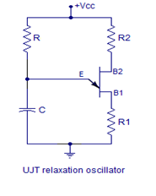
The circuit diagram of a UJT relaxation oscillator is given below.
R1 and R2 are current limiting resistors. Resistor R and capacitor C determines the frequency of the oscillator.
The frequency of the UJT relaxation oscillator can be expressed by the equation,
F = 1/ (RC ln(1/(1-η))
where η is the intrinsic standoff ratio and ln stand for natural logarithm.

Slide 7
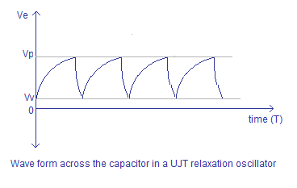
When power supply is switched ON, the capacitor C starts charging through resistor R.
The capacitor keeps on charging until the voltage across it becomes equal to 0.7V plus ηVbb.
This voltage is the peak voltage point “Vp” denoted in the characteristics curve. After this point the emitter to RB1 resistance drops drastically and the capacitors starts discharging through this path.
When the capacitor is discharged to the valley point voltage “Vv”, the emitter to RB1 resistance climbs again and the capacitor starts charging.

Slide 8
IC 555 TIMER

Slide 9
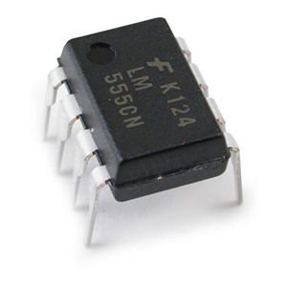
The 555 Timer
The 555 Timer is one of the most popular
and versatile integrated circuits ever produced.
It is 50 years old and still being used.
It is a combination of digital and analog circuits.
It is known as the “time machine” as it performs a wide variety of timing tasks.
The 555 timer IC
is shown here.

Slide 10
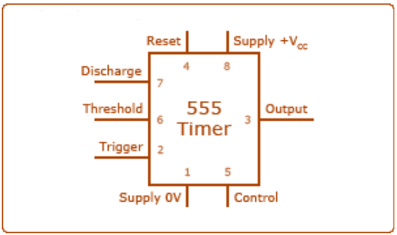
555 Timer Pin Connection

Slide 11
555 Timer Pin Function
PIN 1: Ground – Connect this to ground. Remember to connect all grounds in a circuit together.
PIN 2: Trigger – A short low (less than 1/3 Vcc) pulse on the trigger starts the timer. By connecting this to ground we "turn on" the 555 timer.
PIN 3: Output – During a timing interval, the output stays at +VCC. Can source up to 200ma.
PIN 4: Reset – Forces pin 3 low if pulled to ground.
PIN 5: Control – Can be used to adjust threshold trigger voltage. Not used in our applications. Connect to ground with a .01uF cap to eliminate supply noise from Vcc.
PIN 6: Threshold – When threshold crosses above 2/3 Vcc timing interval ends.
PIN 7: Discharge – Connects to ground when output goes low. Controls timing.
PIN 8: Vcc – Power supply. Typical range 4.5v to 16v.

Slide 12
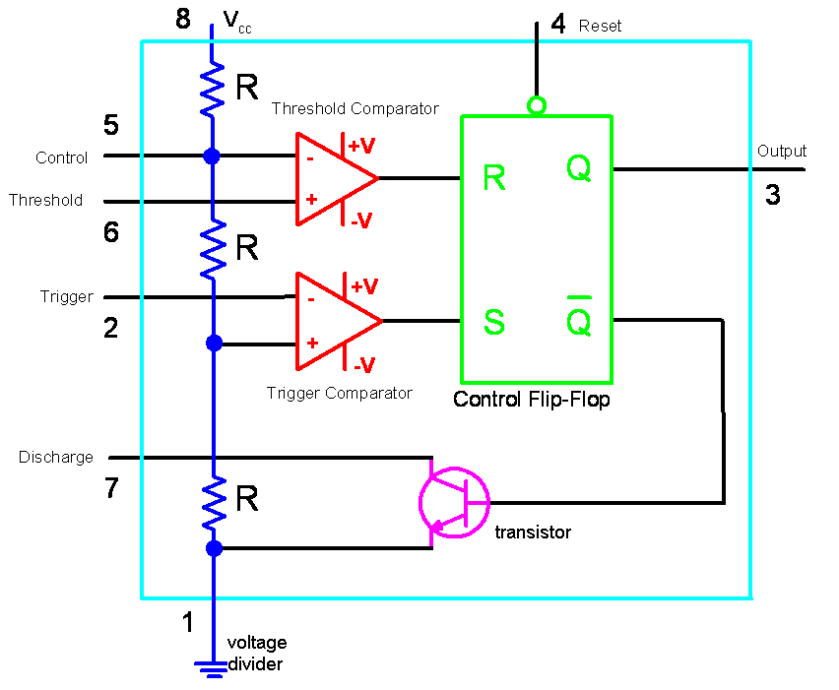
Internal Circuit of 555 Timer

Slide 13
Inside the 555 Timer
The voltage divider (blue) has three equal 5K resistors. It divides the input voltage (Vcc) into three equal parts.
The two comparators (red) are op-amps that compare the voltages at their inputs and saturate depending upon which is greater.
The Threshold Comparator saturates when the voltage at the Threshold pin (pin 6) is greater than (2/3)Vcc.
The Trigger Comparator saturates when the voltage at the Trigger pin (pin 2) is less than (1/3)Vcc

Slide 14
The flip-flop (green) is a bi-stable device. It generates two values, a “high” value equal to Vcc and a “low” value equal to 0V.
When the Threshold comparator saturates, the flip flop is Reset (R) and it outputs a low signal at pin 3.
When the Trigger comparator saturates, the flip flop is Set (S) and it outputs a high signal at pin 3.
The transistor (purple) is being used as a switch, it connects pin 7 (discharge) to ground when it is closed.
When Q is low, Qbar is high. This closes the transistor switch and attaches pin 7 to ground.
When Q is high, Qbar is low. This open the switch and pin 7 is no longer grounded

Slide 15
Applications for the 555 Timer
The 555 is a general purpose IC that can be used for
Precision timing .
Pulse generators – Multivibrators.
Sequential timing.
Time delay generation.
Linear ramp generation.
Cascaded timers.
Frequency dividers.
Voltage-controlled oscillators.
LED flashers.

